Slide 1
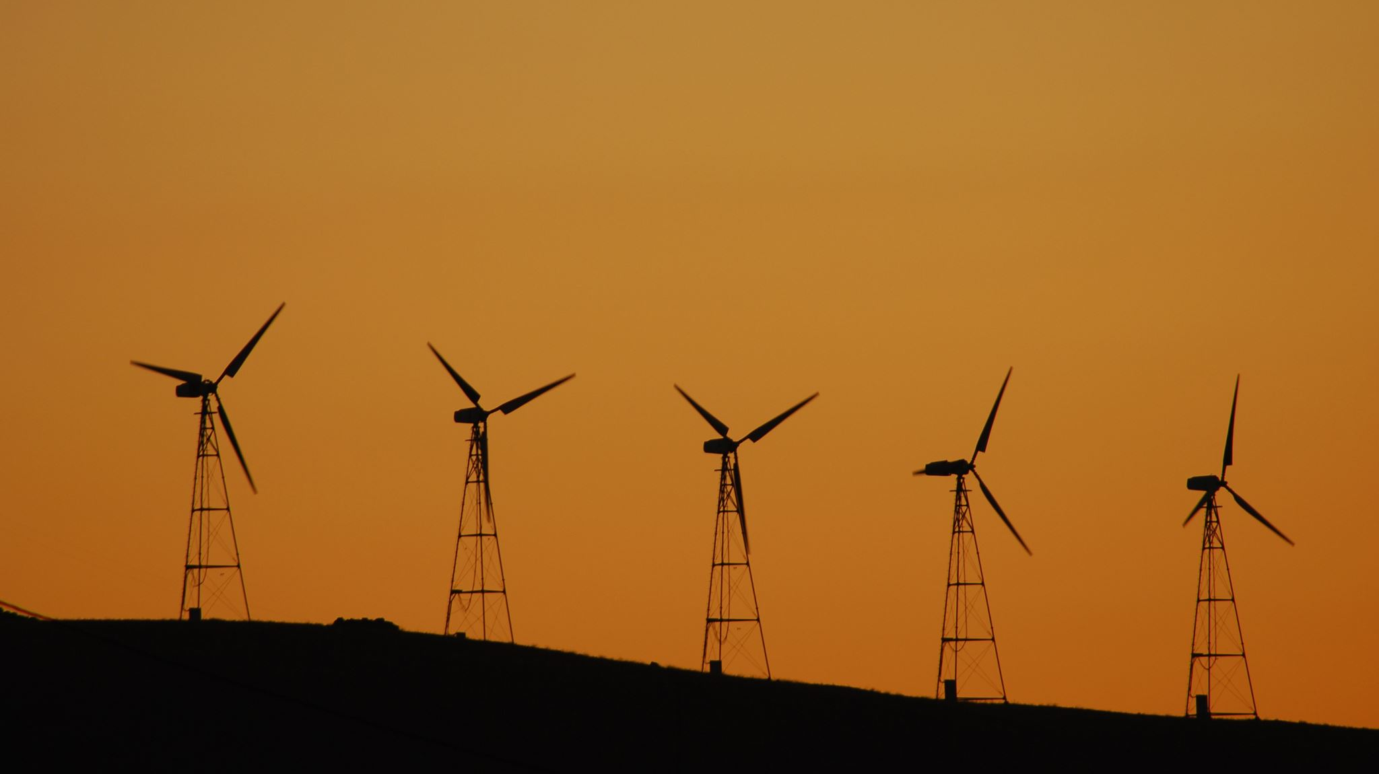
Renewable energy

Slide 2
AGENDA
OUR VESION
OUR MODEL BUILDER
OUR RESULTS
The criteria on which the project was based
Data collection

Slide 3
OUR VISION
Solving the problem of power outages by providing a source of energy based on renewable energy that preserves the environment and at the same time is a source that supports energy.
Our project is concerned with determining the most appropriate places to place windmills based on certain criteria such as climatic conditions and topographical conditions.

Slide 4
The criteria on which the project was based
1- Wind speed: It should be in a place where the wind speed is high (ranging between 6-25 meters/second)
2- Wind direction: It should be placed in the direction of the prevailing winds in the place (north-west)
3- The land should be of high elevation
4- It should be on flat land and not have many elevations and depressions (the slope ranges from 17_25)
5- It should be far from residential and built-up areas and be in areas rangeland and bare ground
6- It should be close to electricity transmission stations to reduce the cost of building the electricity network
7- It should be close to the road and transportation network with ease of maintenance

Slide 5

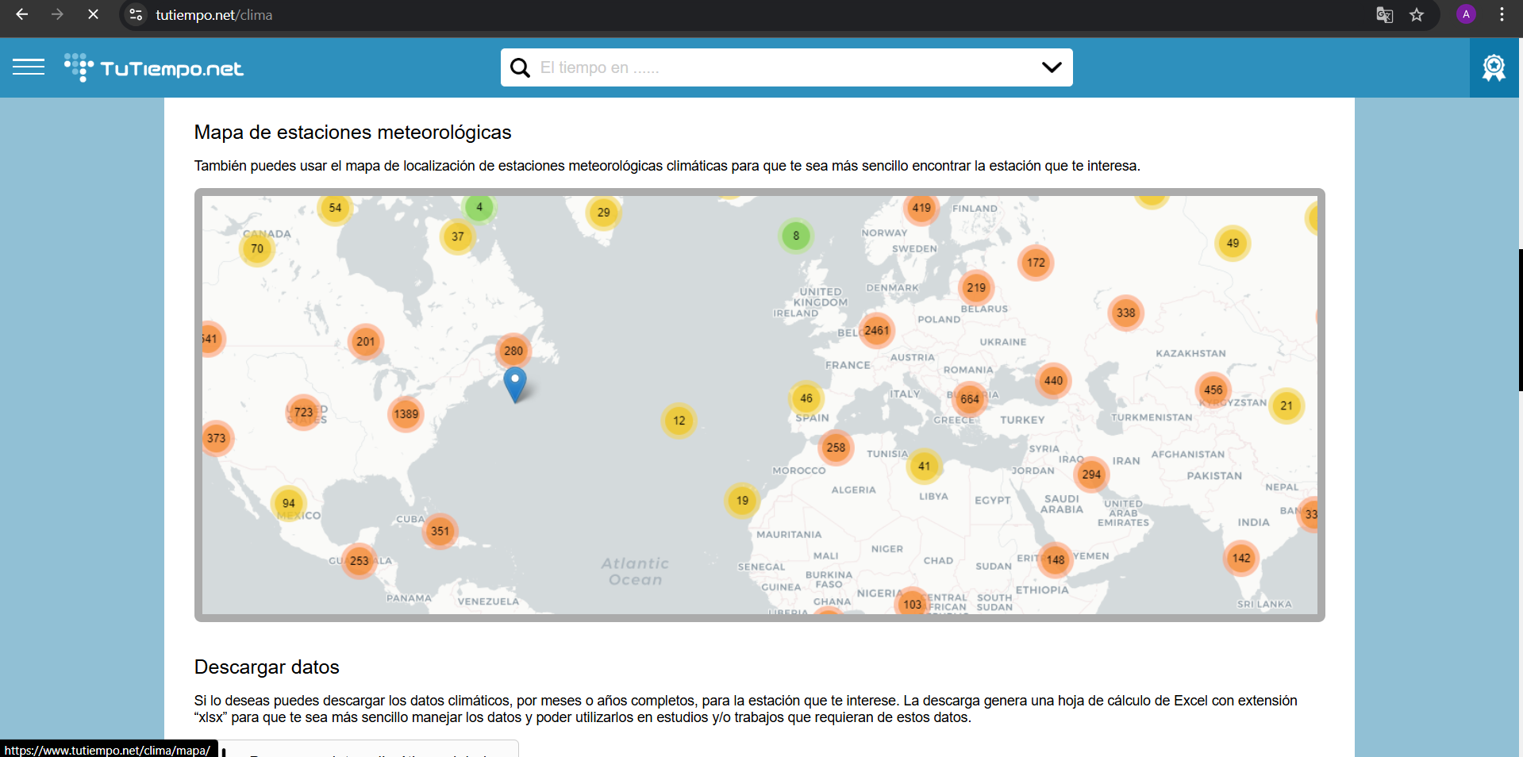
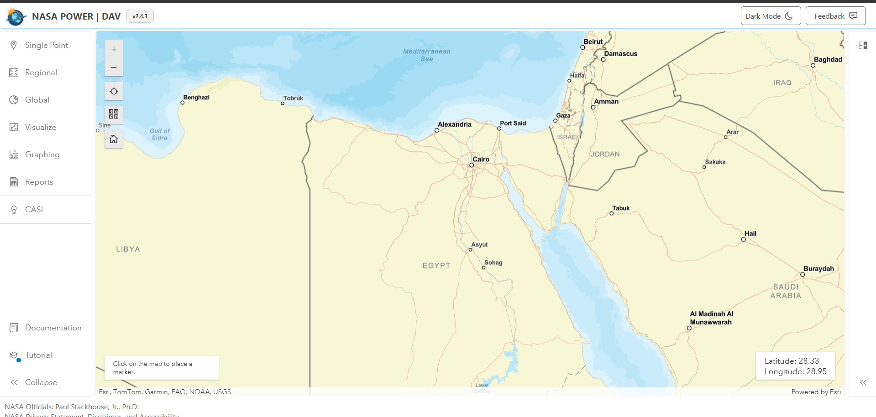
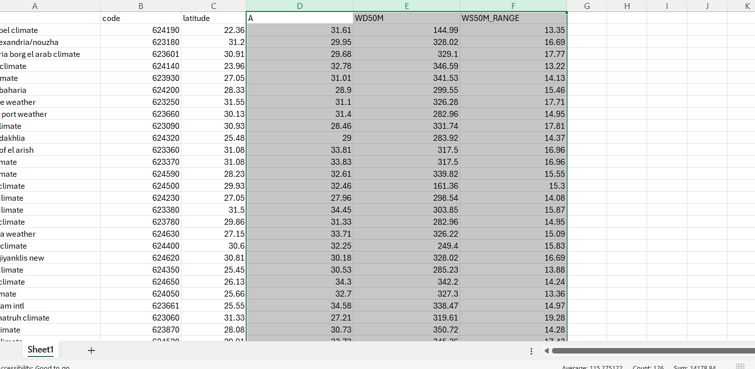
Data collection
Collecting data on climate monitoring stations in Egypt and information on wind speed and direction from the sites
1-nasa power (https://power.larc.nasa.gov/data-access-viewer/)
2-tutempo, (https://www.tutiempo.net/clima)
collecting data in an Excel sheet

Slide 6

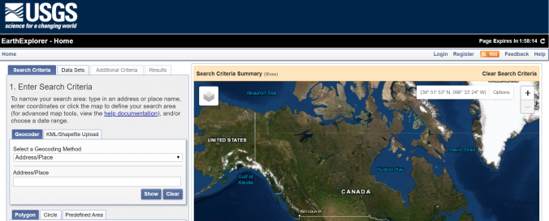
Data collection
Download a digital elevation model from the USGS website(https://earthexplorer.usgs.gov/)

Slide 7
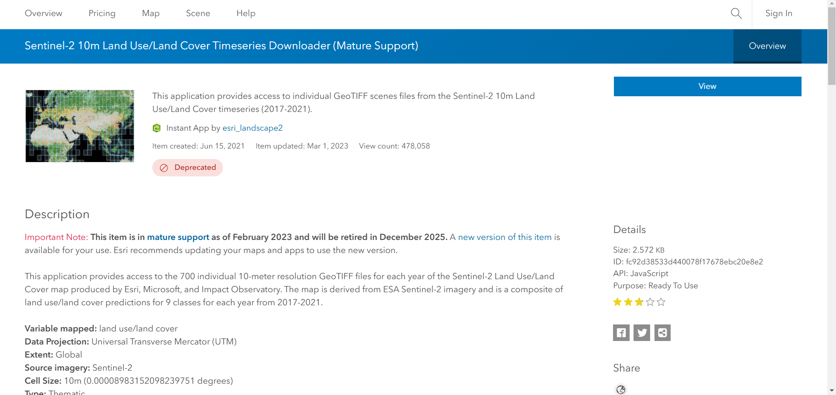

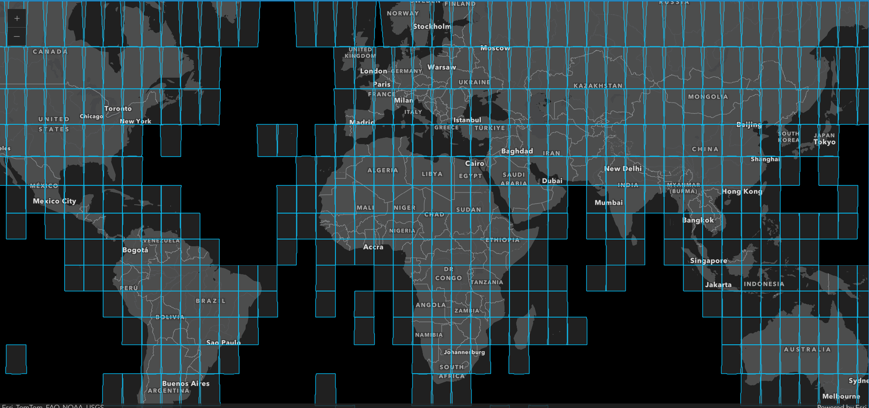
Data collection
Download a shapefile from the Diva GIS website for Egypt's administrative borders and road network(https://diva-gis.org/)
Download a satellite image showing land uses(https://www.arcgis.com/home/item.html?id=fc92d38533d440078f17678ebc20e8e2)

Slide 8
Our model builder
____________

Slide 9
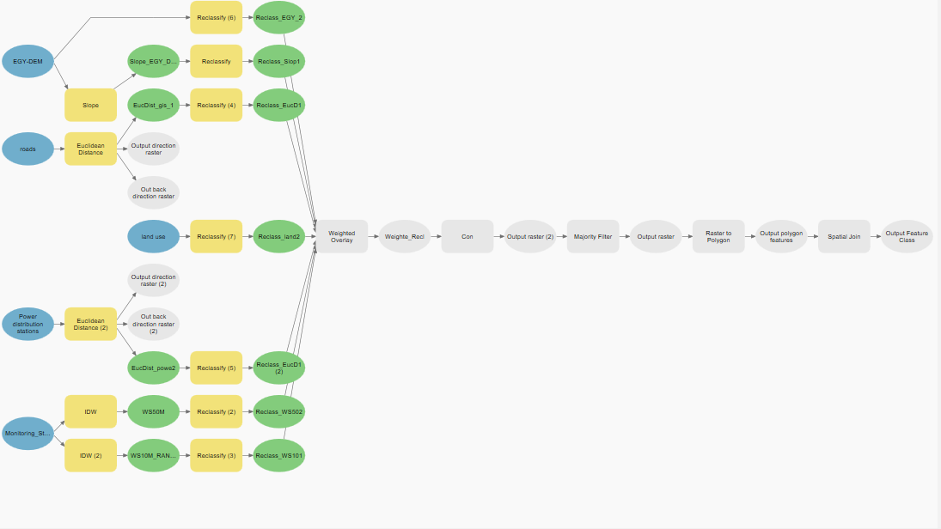

Slide 10
The results
----------------

Slide 11
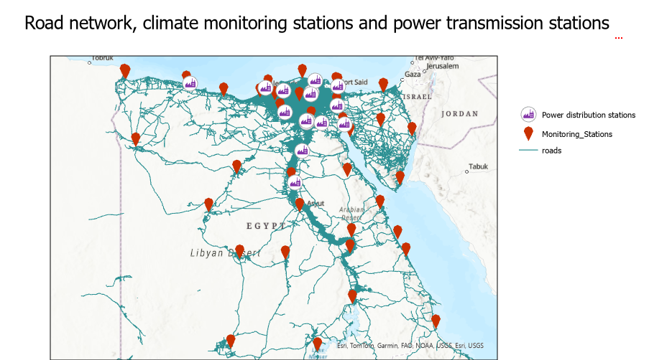

Slide 12
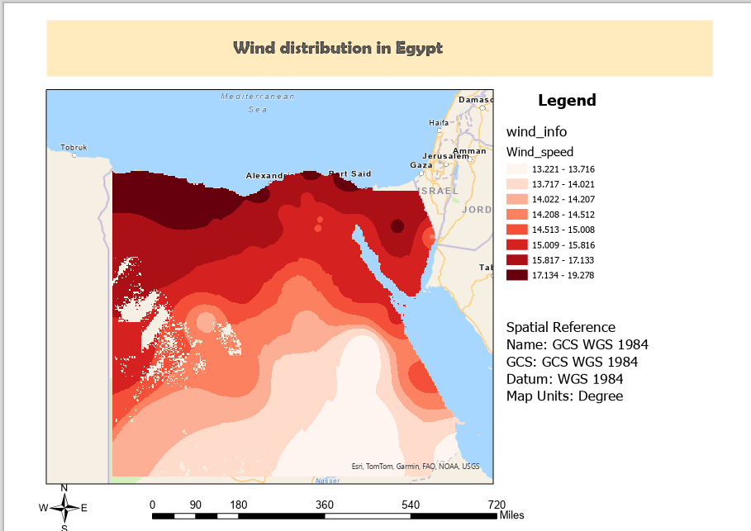

Slide 13
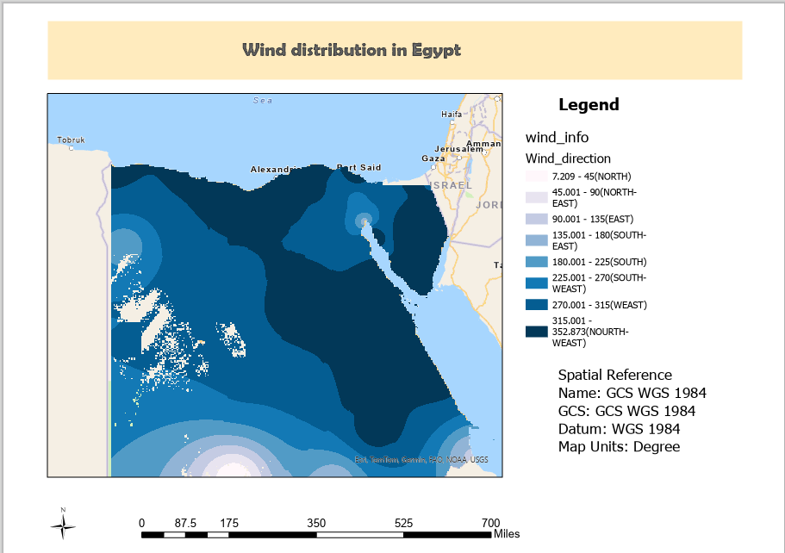

Slide 14
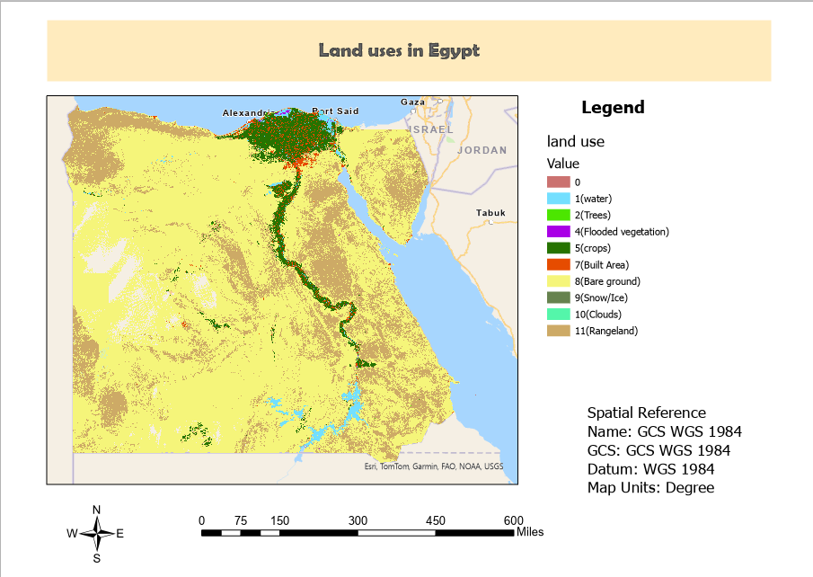

Slide 15
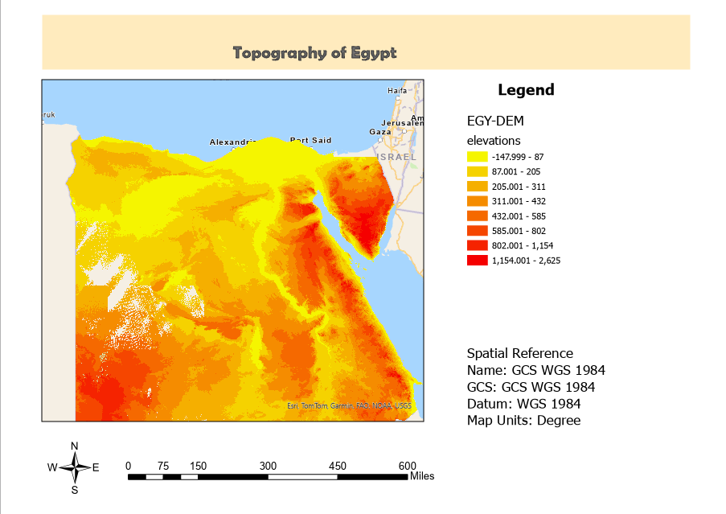

Slide 16
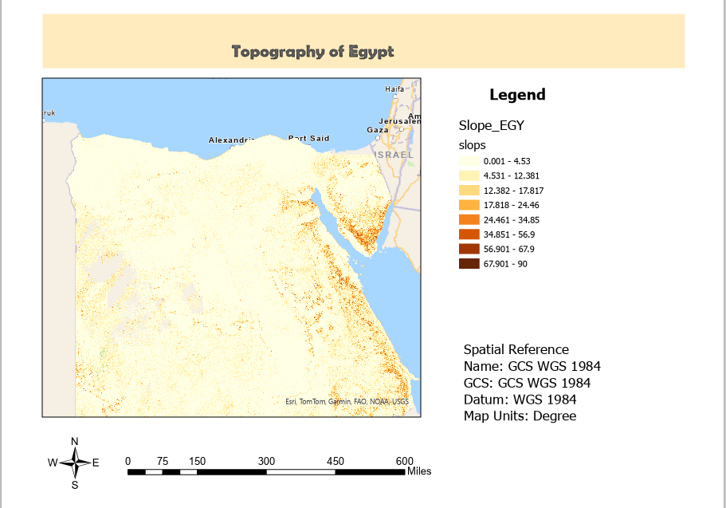

Slide 17
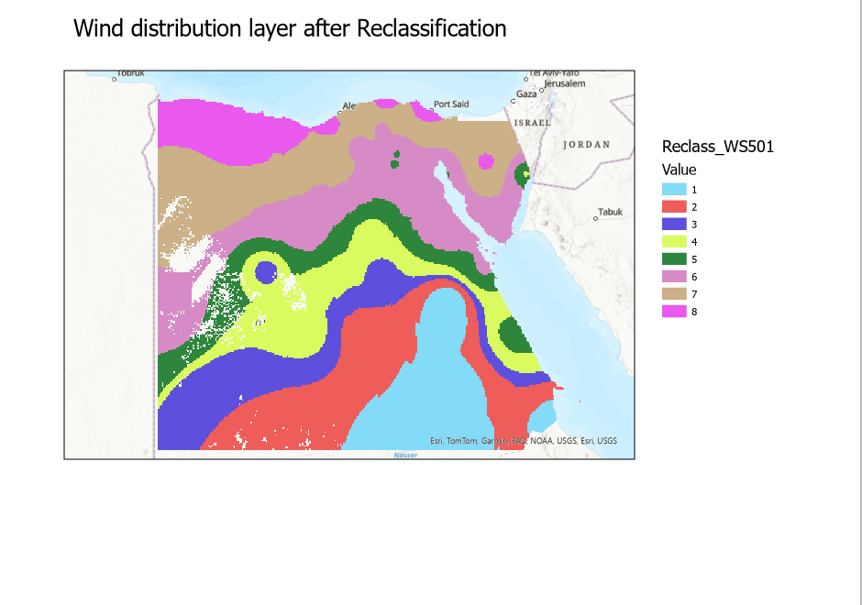

Slide 18
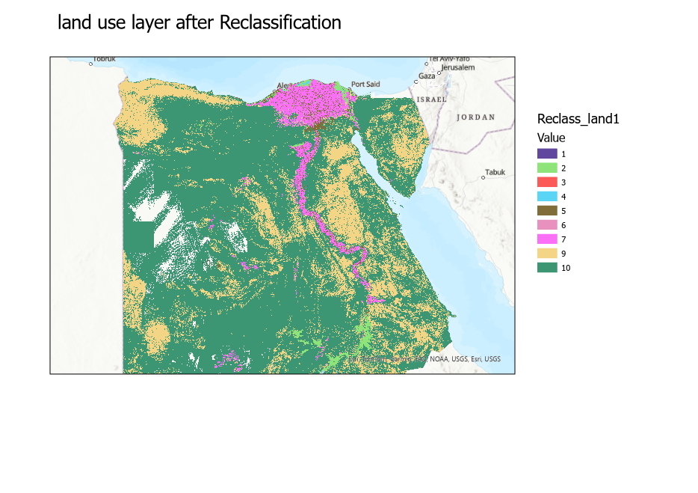

Slide 19
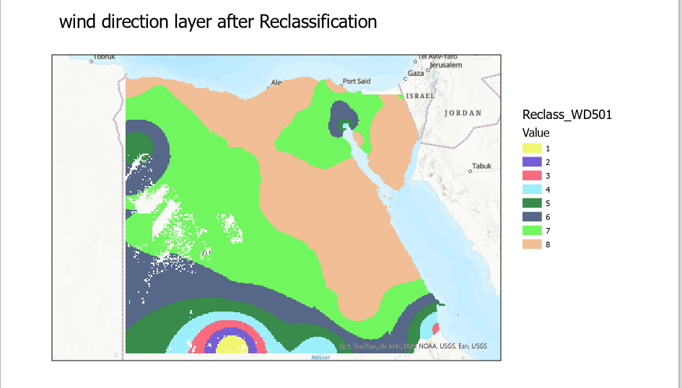

Slide 20
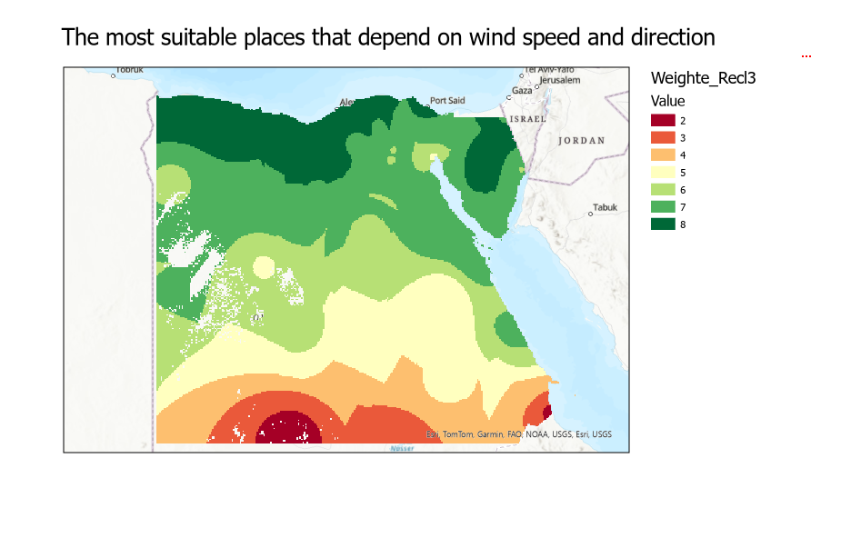

Slide 21
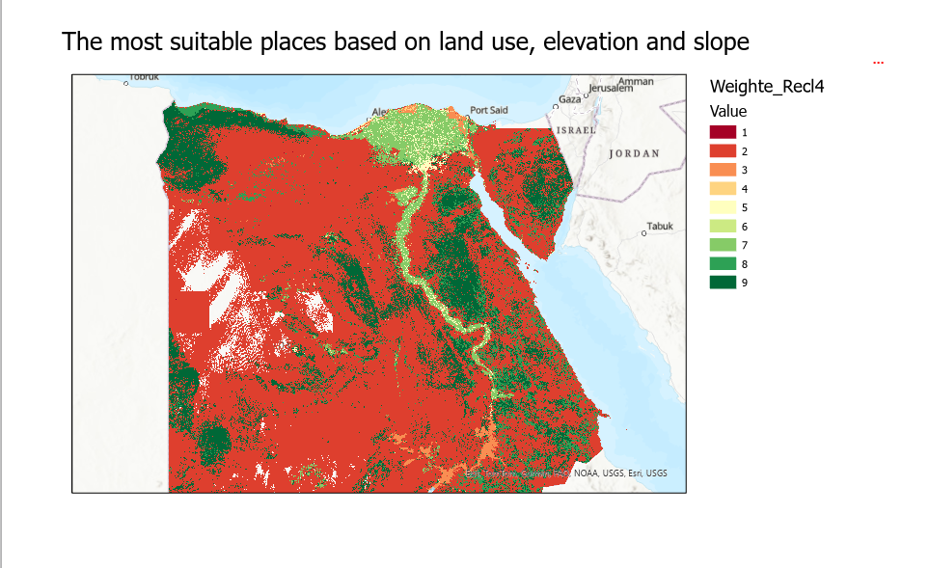

Slide 22
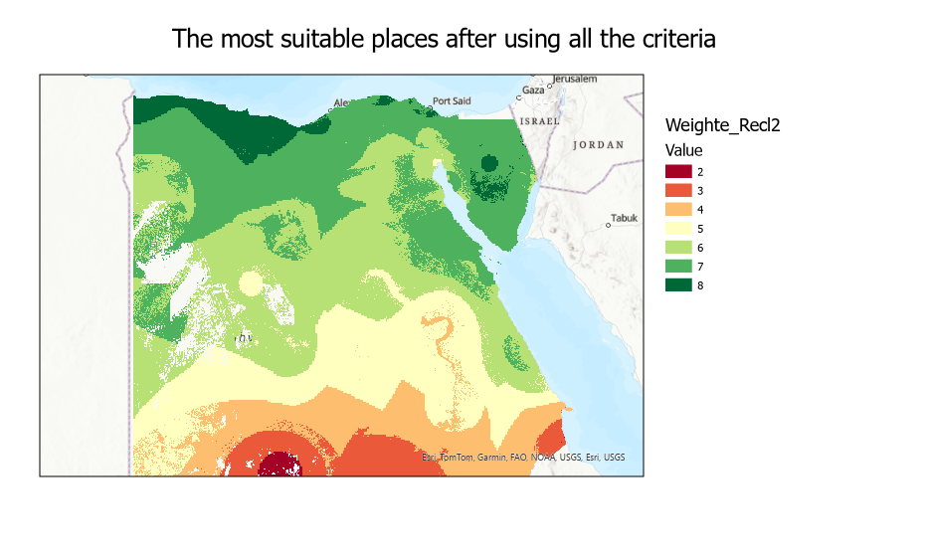

Slide 23
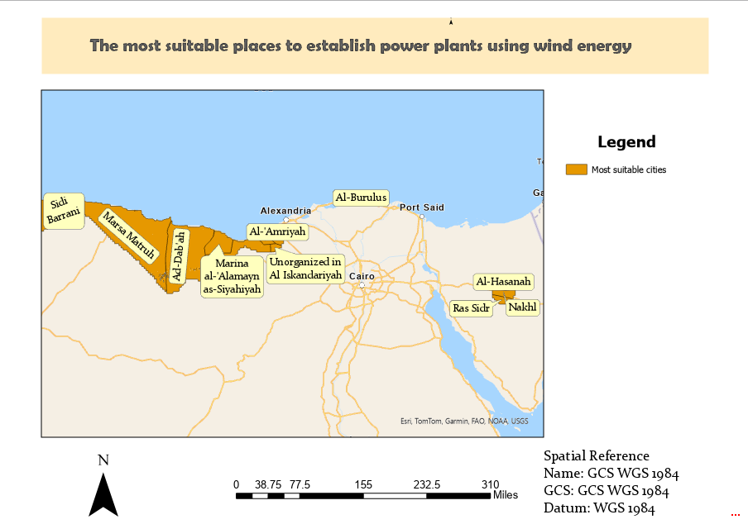
Final resul
According to the analyses carried out, it became clear that these are the most suitable places.

Slide 24
Thanks for your attention

